Slide 1
Ticket Automation System Automation of ticket creation and response based on the mail (RPA)
Faculty Guide:
Ms. Jayashree R
Assistant Professor
Team members:
Sam Dany R
Ramshankaran Y
Prathvik S
Sanjay R B
Department of CSE, KGiSL Institute of Technology, Coimbatore

Slide 2
Abstract Ticketing systems are one of the most important pieces of software used by top service providers and customer support operations. These systems allow teams to capture, manage, and track the status of customer issues in an organized and highly-collaborative manner If the details are incomplete (e.g. customer id is missing), send a mail to customer asking for missing details and Link the subsequent responses from the customer to the original ticket. Recognize the bounced mails and initiate appropriate action via sending auto response to template-based mails (complaints/queries) i.e. no free text.
Department of CSE, KGiSL Institute of Technology, Coimbatore

Slide 3
Area Introduction-Existing system
User needs specific solutions to the problem arise.
Queries are send to the system for processing it.
Each queries arrived assigns a unique ticket.
A big support team available to solve the problems.
Queries are stored in queues which are equally partitioned and assigned to each members in the team.
Team has a great stress when solving the same queries repeatedly.
Department of CSE, KGiSL Institute of Technology, Coimbatore

Slide 4
Proposed System
Advantages over existing method:-
Effective in both Installation and working with the Queues.
Previously solved solutions are stored in a separate Database.
When same queries arise by the other users, then it match to the saved results.
This makes the Ticketing System faster comparatively.
Applies certain algorithms (Sequential / Priority) to process the queries even more faster.
Splits entire queries by word tokenization.
Missing Details and Fraud are identified by NLP, then updates the information to existing tickets accordingly.
Department of CSE, KGiSL Institute of Technology, Coimbatore

Slide 5
Advantage
More affordable comparing to other automation tool
Even smaller companies can easily adopt to this ticketing system due to reduced cost and man power.
Department of CSE, KGiSL Institute of Technology, Coimbatore

Slide 6
Future enhancements
Will eliminate the process of sending the mails regarding their complete data (e.g. customer id is missing) to the customer.
The system which has this RPA workflow can be considered as a hub system and this hub plays as a role of routing the tickets to the particular persons system(node) according to their domain. This overcomes the process of installation of this workflow in all the system.
Department of CSE, KGiSL Institute of Technology, Coimbatore

Slide 7
Literature Review
Drawbacks of existing methods
Inaccurate solutions provided to the customers.
If any missing details or any fraud, system is not much effective to overcome it.
In case the details given by the customer is insufficient, System will response with unwanted result.
Doesn’t follow any specific methods in solving the customer request (FIFO, Round Robin, Priority Queue).
Department of CSE, KGiSL Institute of Technology, Coimbatore

Slide 8
Module Split up Module 1: Mail Trigger Module 2: Process Mail Module 3: Check Mail Module 4: Database Connection
Department of CSE, KGiSL Institute of Technology, Coimbatore

Slide 9
Data flow Diagram – Level 0
Raise Tickets
Notification to
authorised person
User
Keyword Database
Department of CSE, KGiSL Institute of Technology, Coimbatore

Slide 10
Data flow Diagram – Level 1
End-User
send mail
If exist
yes
User
database
no
ticket
Support team
Department of CSE, KGiSL Institute of Technology, Coimbatore

Slide 11
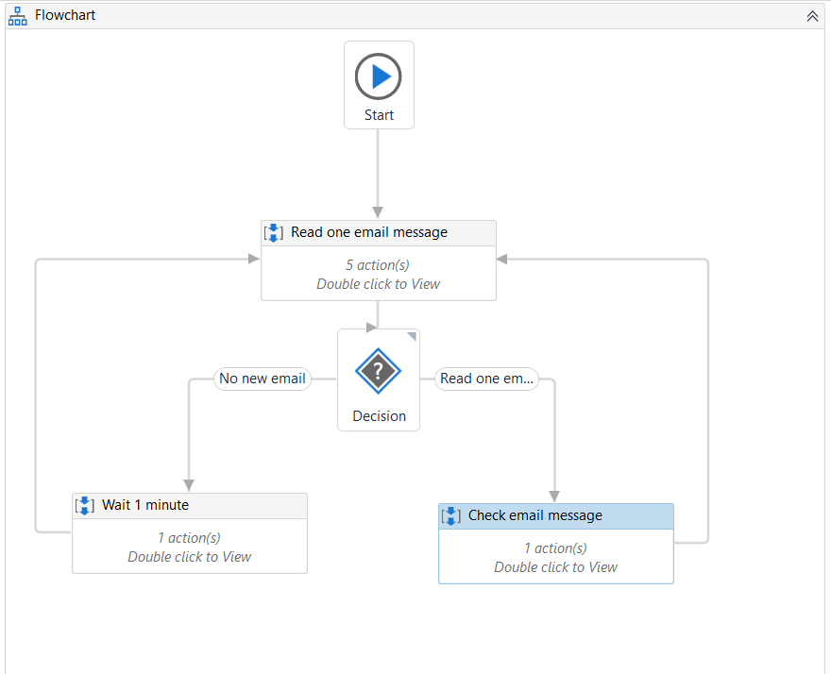
Mail Sequence:
Department of CSE, KGiSL Institute of Technology, Coimbatore

Slide 12
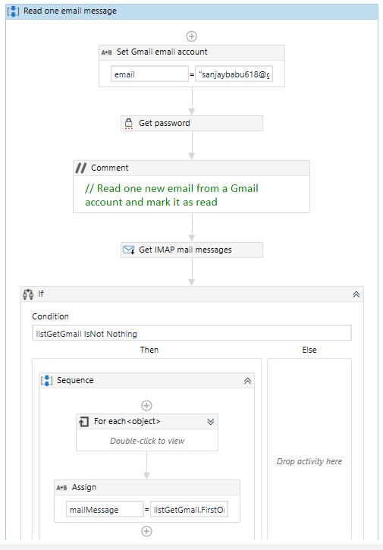
Read one mail
Department of CSE, KGiSL Institute of Technology, Coimbatore

Slide 13
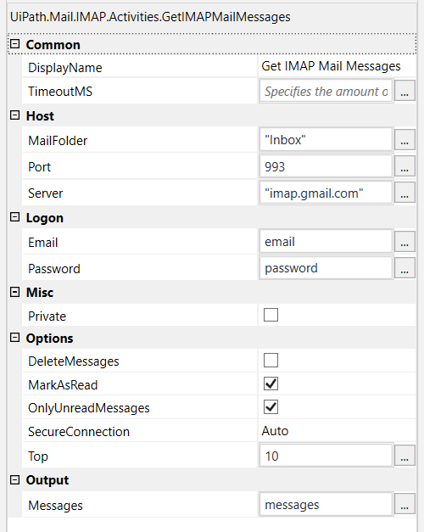
Activities
Department of CSE, KGiSL Institute of Technology, Coimbatore

Slide 14
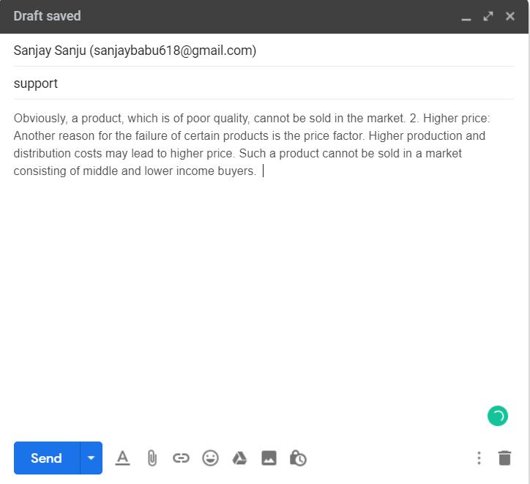
Query to customer support
Department of CSE, KGiSL Institute of Technology, Coimbatore

Slide 15
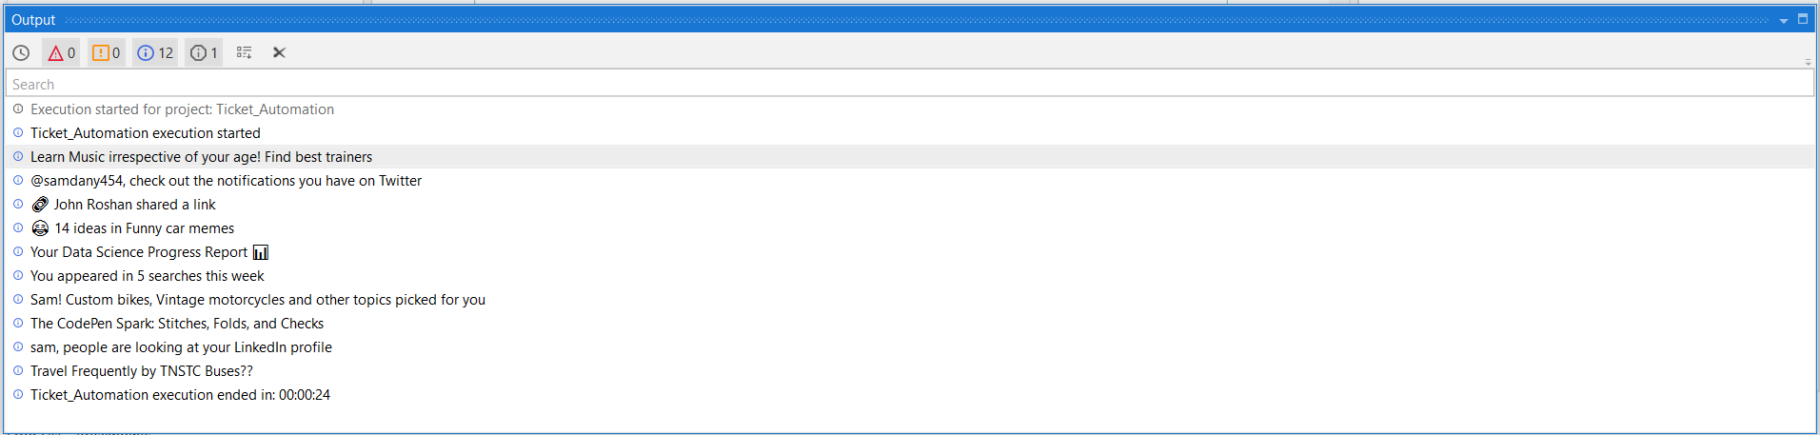
Output
10 Mail subjects
Department of CSE, KGiSL Institute of Technology, Coimbatore

Slide 16
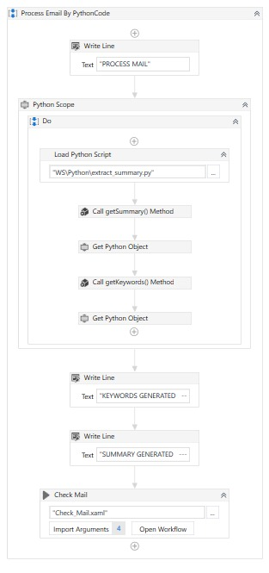
Process Mail
Department of CSE, KGiSL Institute of Technology, Coimbatore

Slide 17
Text Summarization Steps
Convert Paragraphs to Sentences
Text Pre-processing
Tokenizing the Sentences
Find Weighted Frequency of Occurrence
Replace Words by Weighted Frequency in Original Sentences
Sort Sentences in Descending Order of Sum
Department of CSE, KGiSL Institute of Technology, Coimbatore

Slide 18
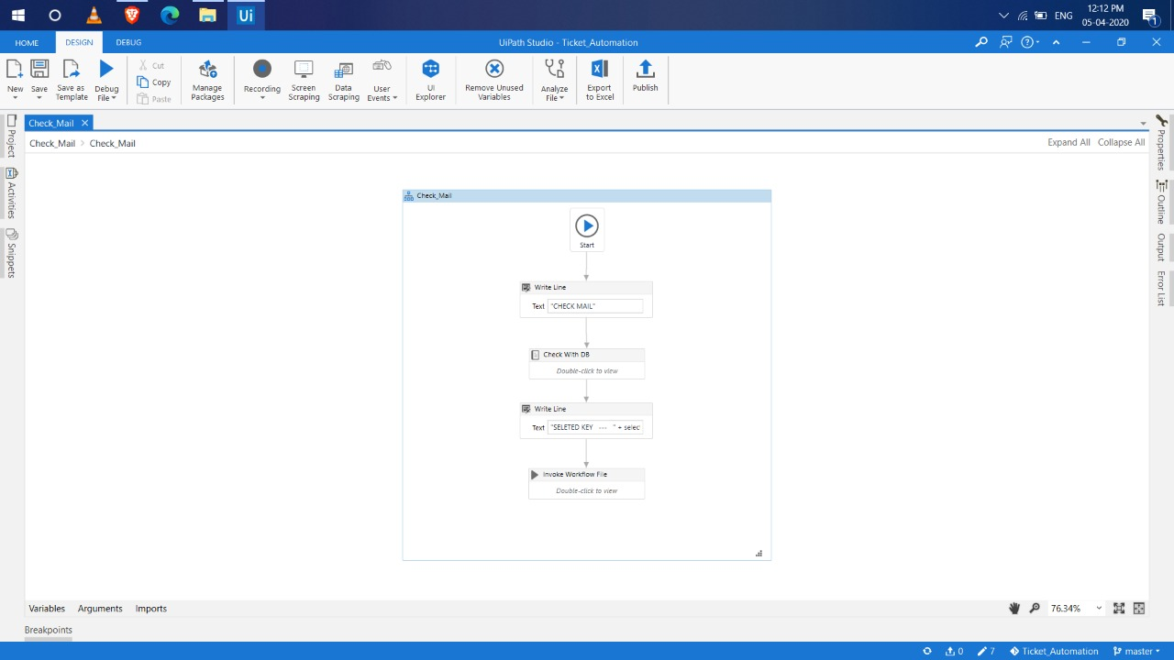
Check Mail
Department of CSE, KGiSL Institute of Technology, Coimbatore

Slide 19
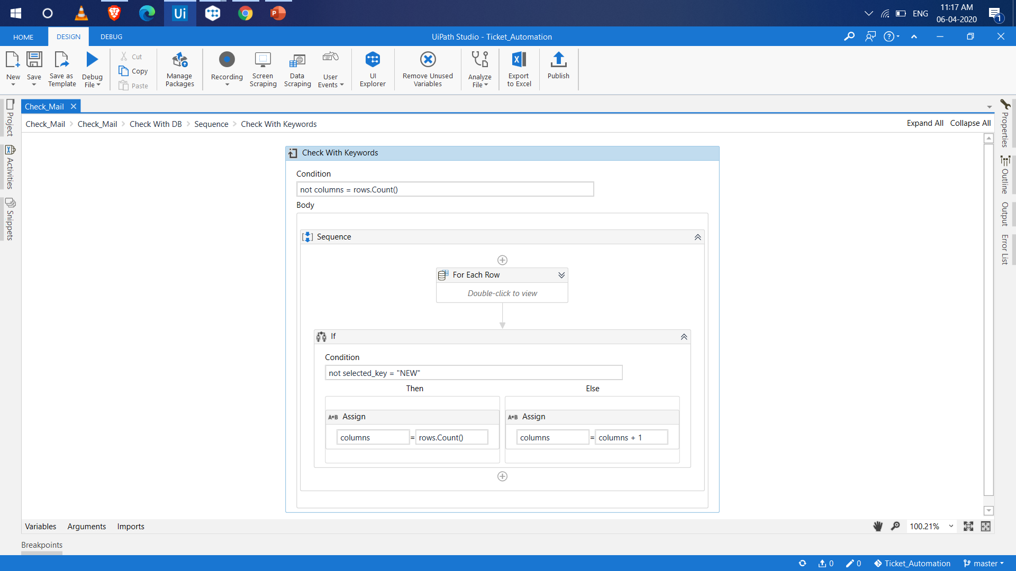
Keyword to keyword match:
Department of CSE, KGiSL Institute of Technology, Coimbatore

Slide 20
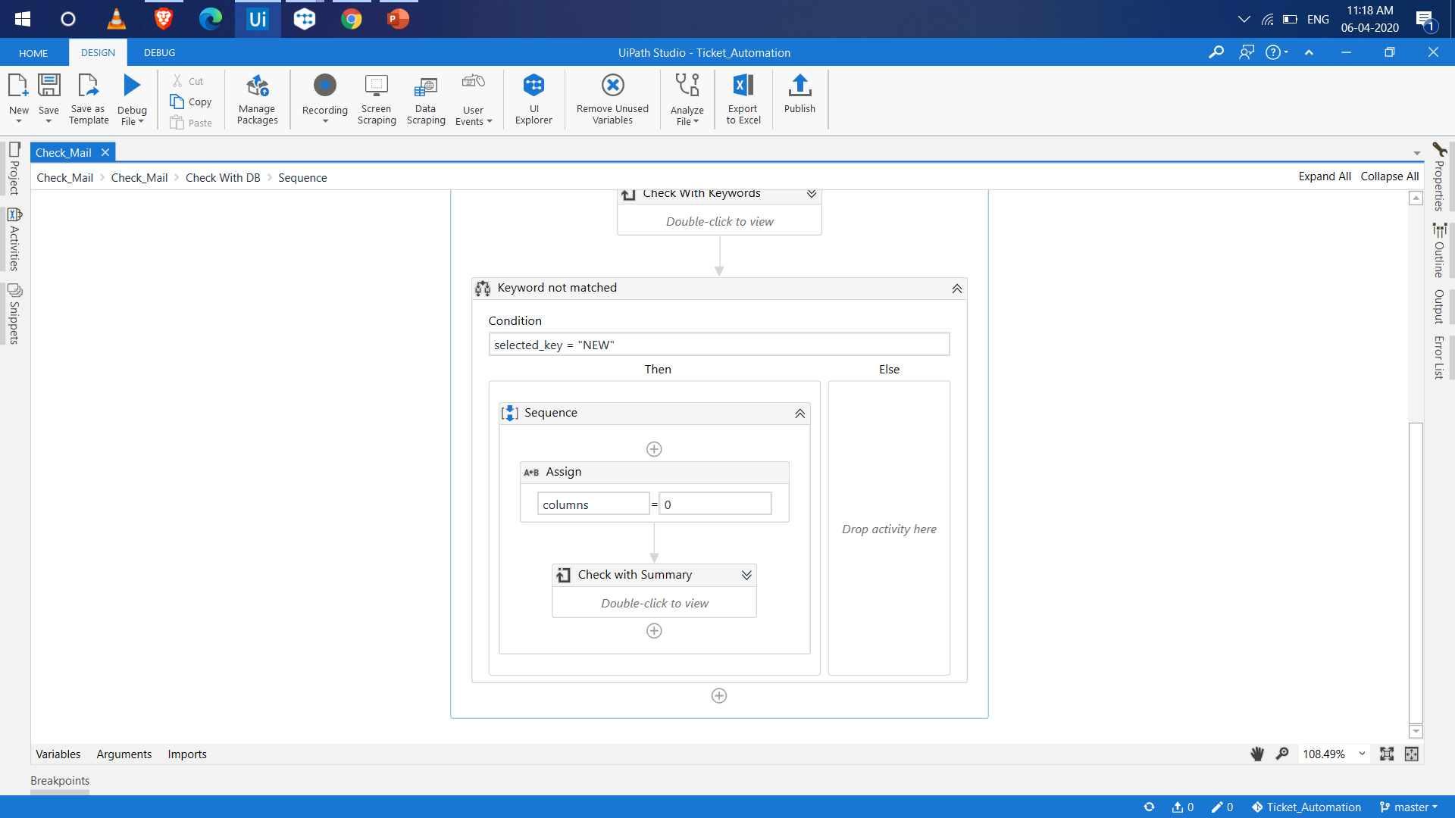
Keyword to summary match:
Department of CSE, KGiSL Institute of Technology, Coimbatore

Slide 21
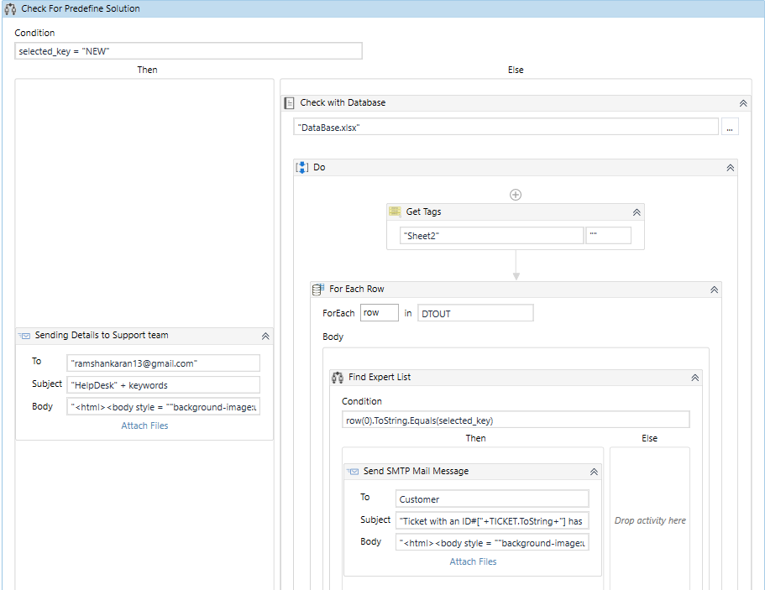
Data Store
Department of CSE, KGiSL Institute of Technology, Coimbatore

Slide 22
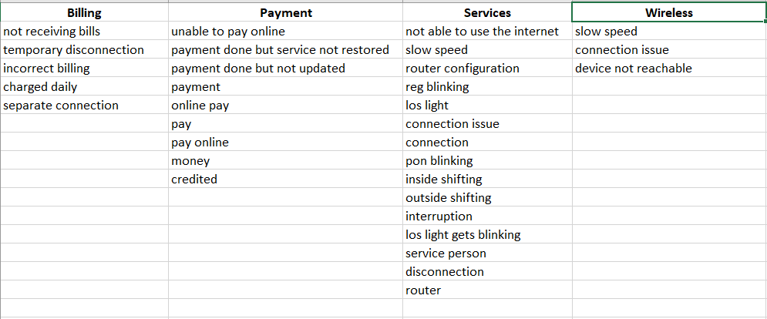
Database (Excel)
Department of CSE, KGiSL Institute of Technology, Coimbatore

Slide 23
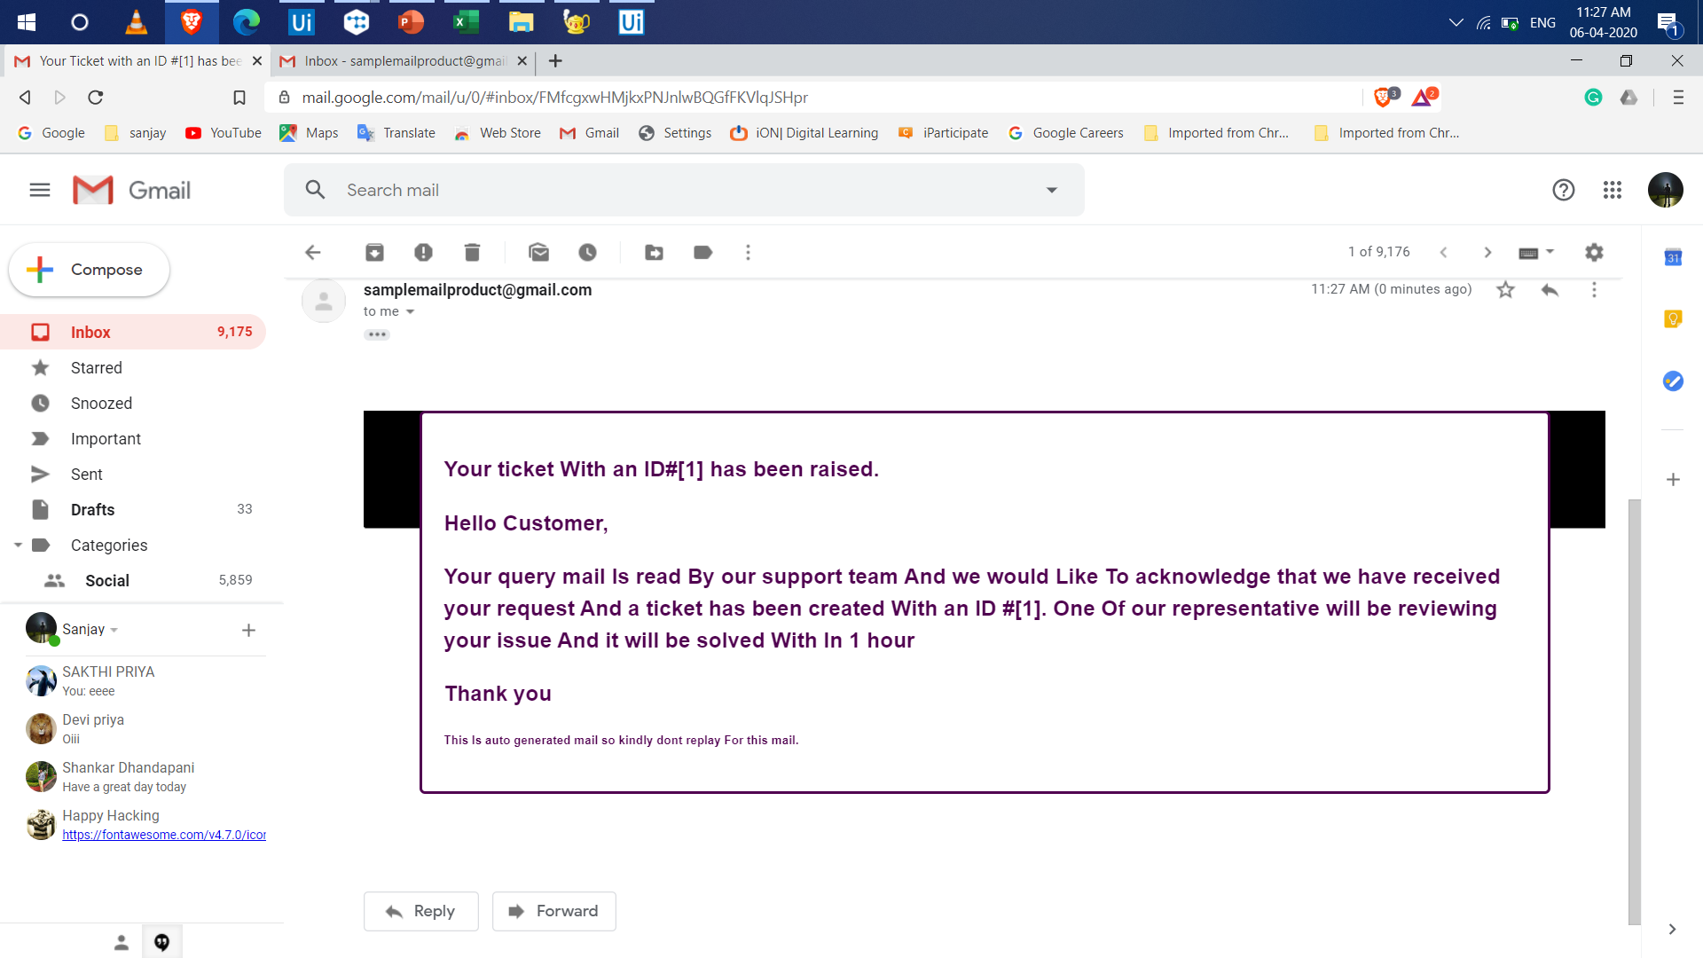
Ticket Raising
Department of CSE, KGiSL Institute of Technology, Coimbatore

Slide 24
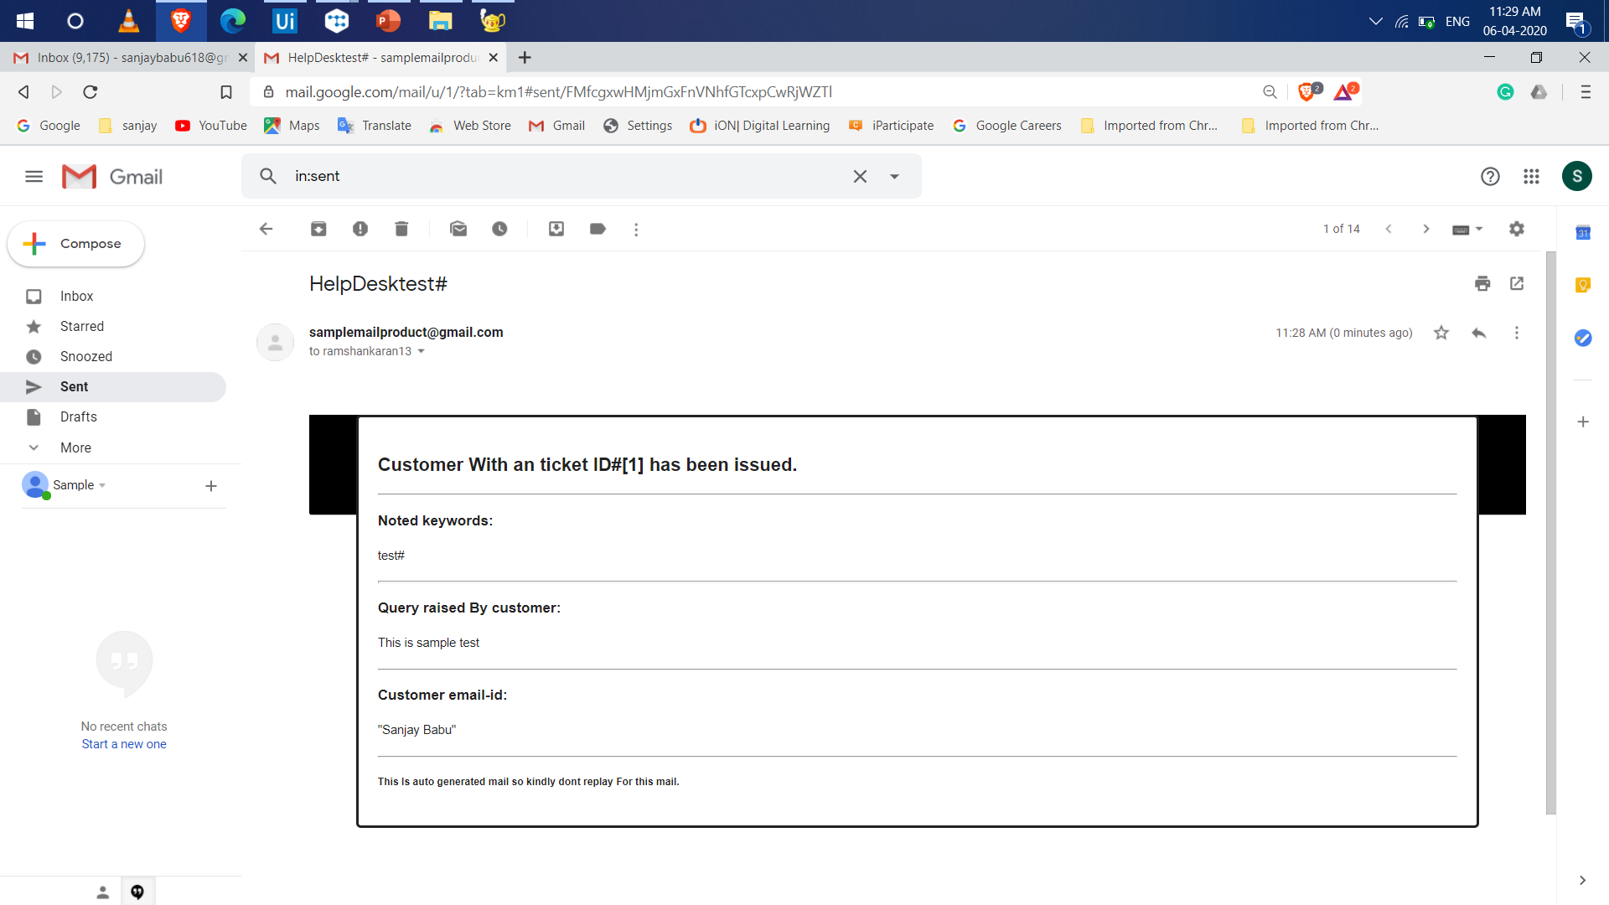
Support Team
Department of CSE, KGiSL Institute of Technology, Coimbatore

Slide 25
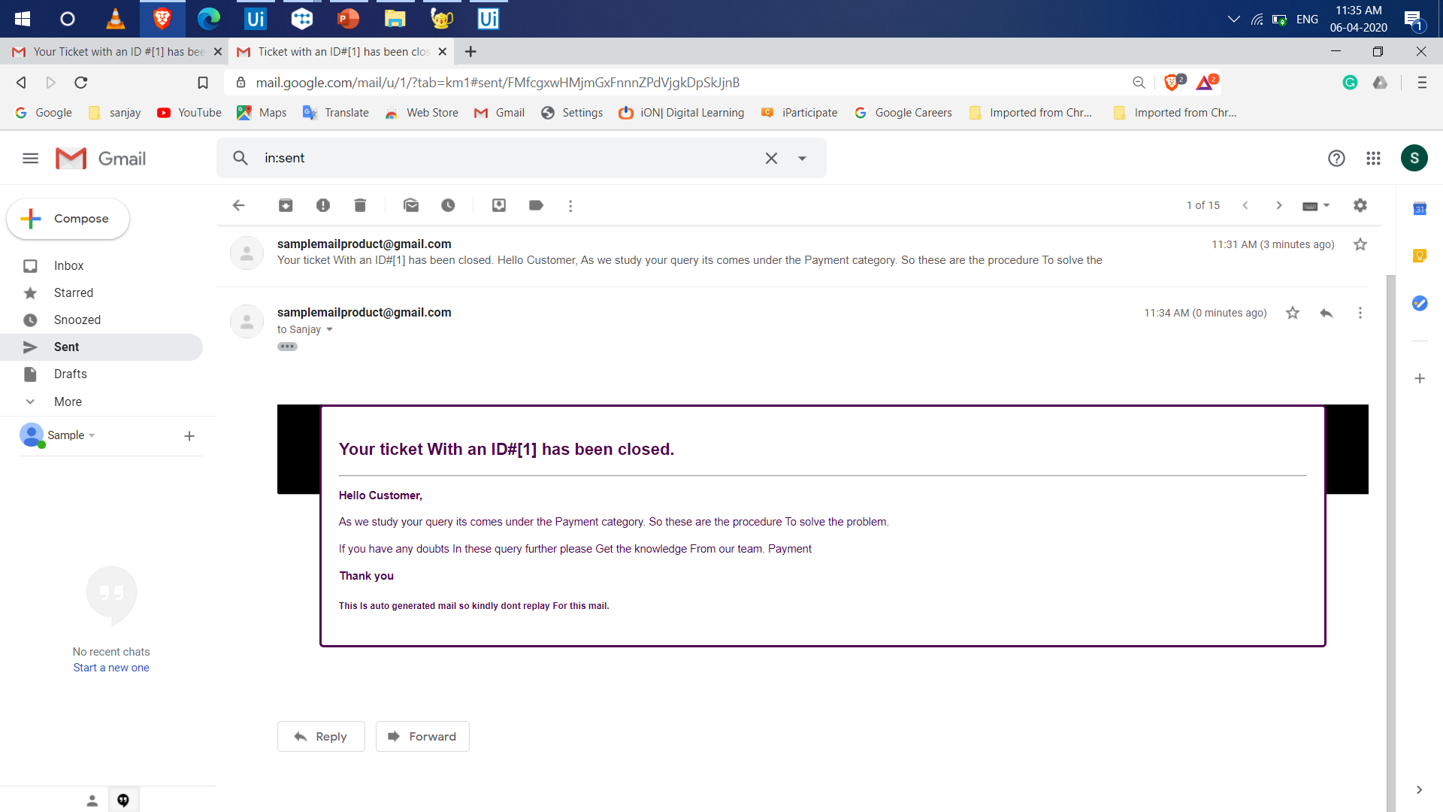
Ticket Closing
Department of CSE, KGiSL Institute of Technology, Coimbatore

Slide 26
References
https://help.teamsupport.com/1/en/topic/ticket-automation - Ticket Automation
https://www.uipath.com/blog/use-cases-it-transformation-rpa?hs_amp=true – UiPath
https://www.nltk.org/ - NLP
GitHublink – https://github.com/sanjaysanju618/Ticket-Assignment-Automation
Department of CSE, KGiSL Institute of Technology, Coimbatore

Slide 27
Thank You
Department of CSE, KGiSL Institute of Technology, Coimbatore

